Slide 1

IBM Build Engineering watsonx for MAS partners
Megha Jingar
AI Engineer, IBM Build Engineering EMEA
Andreas Steen
EMEA Build Technical Leader

Slide 2

EMEA Build ↷ Watsonx for Maximo partners
Agenda
Mission statement and target Personas
Our offering : Workshop for inspiration and enablement
Sample use-cases : To inspire the partners on the art of the possible
Summary
IBM Build Engineering, in collaboration with CSM, have created an inspirational workshop, with hands-on exercises, that will show Maximo partners how they can build customer facing solutions to increase their own business.
The material was created for a partner in UK, who had bought watsonx but had not yet investigated using it for their solutions.
After the workshop(s), the partner wanted to continue exploring so Client Engineering did Business Value and Use-Case workshops and we are now planning for a pilot to start.

Slide 3
EMEA Build ↷ Watsonx for Maximo partners
Business Partner in UK
Our ”Patient Zero”
They have 500k worth of watsonx as a starter pack but had not yet started any AI projects.
What is done?
Hands-on enablement for 4 of their consultants
Material created by Build Engineering and CSM UK
Showing the art of the possible and prove that they can do it.
Business Framing (Ideation and Qualification) to identify some use-cases that have market need and business viability
Next step
Scoping of the use-cases
Co-create defined use-cases
Expansion
Approach additional partners with the enablement offer to spark interest.
Get partners to present at the Maximo conferences to increase the pressure on the laggers.
Mission : Get Maximo partners to build solutions based on watsonx
Very few Maximo partners have embraced AI (from IBM).
If AI solutions are built using other vendors, Maximo can face being reduced to a back-end solution with less end user value.
Maximo has a large install base and loyal clients & users but still a mostly untapped AI pipeline source.
But AI is already included in MAS
Yes, but it’s limited and mainly targeted to use Maximo data.
wx4mas intent is to use multiple data sources to strengthen watsonx as a generic AI platform and Maximo as a key data source
MAS is not a generic AI platform so can not be used for use-cases unrelated to Maximo.
Partners / Clients will not have two separate platforms for AI
MAS skill requirements would limit the target audience
Upgrade cycle and feature expansion is different between MAS and watsonx

Slide 4
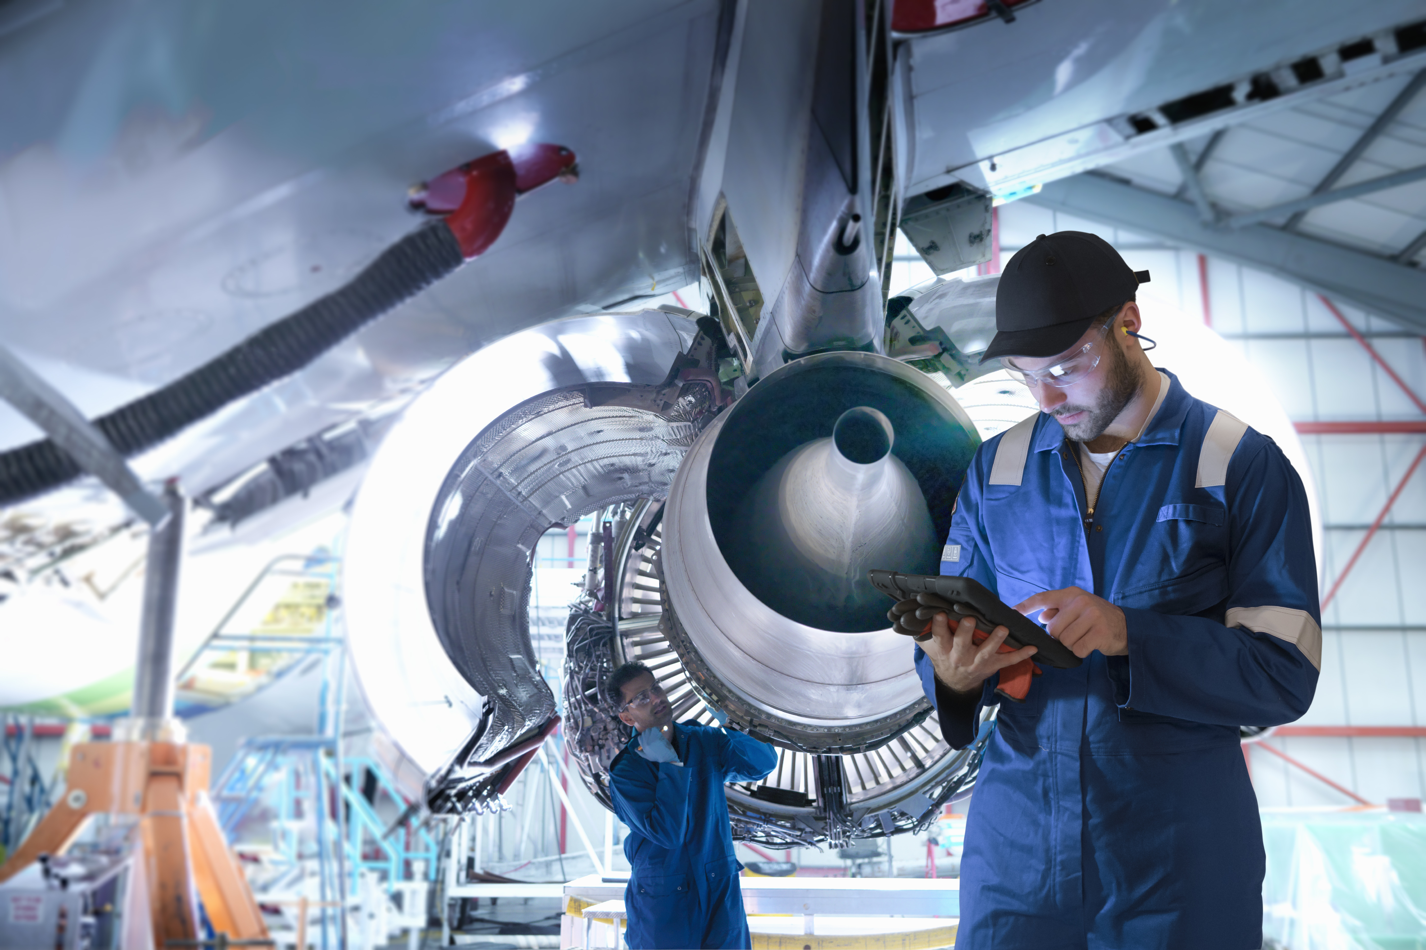
From Data to Decisions AI-Driven Asset Management with Watsonx & Maximo for Planners
Next-gen Work Order Intelligence
Global Work Order Management Systems Market by 2029
USD 1.2B
Potential Use Cases
Persona : Supervisor / Maintenance Planner
Automatically generate job plans from asset maintenance manuals for use in work orders
Automatically Break down job plan tasks into more detailed and meaningful steps for use in workorders.
Generate Predictive Maintenance Plans – Leverage AI models to analyze predictive maintenance data along with external sources, such as weather conditions, to automatically generate optimized work order plans.
Work Order Optimization – AI-driven suggestions for scheduling, resource allocation, and priority management.
Voice-enabled Work Order Management – Enable hands-free work order updates and status checks using voice commands.
30-40% reduction in unplanned maintenance
Recognize anomalies and create work from alerts, service requests, and performance indicators
Scheduling, resource allocation, and priority management
Notes:
Next-gen Work Order Intelligence
Recognizing Anomalies & Automating Workflows
With AI-powered analytics, Maximo can detect anomalies in asset performance, service requests, and real-time alerts.
Instead of waiting for failures, AI proactively identifies potential issues and automatically generates work orders, ensuring timely intervention.
Reducing Unplanned Maintenance by 30-40%
Traditional work order management is reactive, leading to costly downtime and inefficiencies.
AI-driven work order automation optimizes scheduling, resource allocation, and failure predictions, leading to 30-40% fewer unplanned maintenance events (IBM research).
This improves asset reliability, reduces costs, and enhances operational efficiency across the enterprise.
Key Takeaway: By integrating AI with Maximo, organizations can transform reactive maintenance into proactive, data-driven decision-making, ultimately reducing disruptions and maximizing asset performance.
Use cases tagged to Next-Gen Work Order Intelligence
Auto-Generating Job Plans from Manuals
Maximo consultants often spend hours translating OEM manuals into job plans — a manual, error-prone process.
With watsonx-powered generative AI, manuals are automatically converted into structured Maximo job plans, complete with tasks, labor, materials, and safety steps.
This accelerates setup time, improves consistency, and ensures alignment with equipment manufacturer guidelines — all with minimal manual effort.
Predictive Maintenance – Apply AI models to analyze historical asset data and predict failures before they occur.
Work Order Optimization – AI-driven suggestions for scheduling, resource allocation, and priority management.
Voice-enabled Work Order Management – Enable hands-free work order updates and status checks using voice commands.
Key Takeaway:
AI-powered automation and intelligent decision-making in Maximo with watsonx enhance productivity, reduce downtime, and streamline operations—driving efficiency across the enterprise
Source :
Work order intelligence : https://www.databridgemarketresearch.com/reports/global-work-order-management-systems-market
AI productivity : https://www.mckinsey.com/capabilities/mckinsey-digital/our-insights/the-economic-potential-of-generative-ai-the-next-productivity-frontier#introduction
Reduction in unplanned downtime - https://www.cm-excellence.com/post/improving-asset-performance-for-a-global-manufacturer
Box notes for use case details : https://ibm.ent.box.com/notes/1823012260684

Slide 5

From Data to Decisions AI-Driven Asset Management with Watsonx & Maximo for Technicians
Enhanced productivity using Watsonx Agentic AI
Persona : Reliability Engineer/ Technician
Potential Use Cases
Empowering Field Technicians with Instant, Language-Friendly Work Guidance - Field engineers receive clear, step-by-step instructions to complete work orders through simple voice or chat interactions
Seamless Workflow Orchestration Across Enterprise Systems - Intelligent coordination enables smooth, end-to-end business processes by connecting and aligning actions across other Enterprise systems ERP, SCADA, SAP etc and derive insights.
Data validation of incomplete and missing data in Maximo using Watsonx AI Agents
McKinsey : AI could potentially increase productivity by
up to 40%
Improve Field Efficiency with Conversational AI
Smart Task Execution using Autonomous AI Agents
Context-Aware Decision-Making
Multi-Agent Collaboration Across Systems
Notes:
Agentic AI for Enhanced productivity
1. Conversational AI for Field Efficiency Technicians(Field engineers, Reliability engineers etc) interact with Maximo via natural language (Voice + Chat) — getting instant insights, asset history, and step-by-step instructions.
Reduces technician downtime and improves first-time fix rate.
2. Autonomous AI Agents for Smart Task Execution
AI agents autonomously initiate, manage, and complete routine tasks like work order creation, escalation, and updates. Frees up human effort, enabling teams to focus on critical issues.
3. Context-Aware Decision-Making Agents understand operational context — asset condition, maintenance history, and business priorities — to take smart, timely actions. Reduces costly delays and reactive firefighting.
4. Multi-Agent Collaboration Across Systems Agents can communicate with other enterprise systems (ERP, inventory, IoT) to orchestrate end-to-end workflows. Enables fully connected operations with minimal human intervention.
Key Takeaway:
AI-powered automation and intelligent decision-making in Maximo with watsonx enhance productivity, reduce downtime, and streamline operations—driving efficiency across the enterprise
Source :
Work order intelligence : https://www.databridgemarketresearch.com/reports/global-work-order-management-systems-market
AI productivity : https://www.mckinsey.com/capabilities/mckinsey-digital/our-insights/the-economic-potential-of-generative-ai-the-next-productivity-frontier#introduction
Reduction in unplanned downtime - https://www.cm-excellence.com/post/improving-asset-performance-for-a-global-manufacturer
Box notes for use case details : https://ibm.ent.box.com/notes/1823012260684

Slide 6

IBM Maximo + Watsonx
Hyper automation for Maximo Deployment & Operations
Driving Productivity & Operational Efficiency for Business Partners
Potential Use Cases
Hyperautomation reduces IT operational costs by ~30%
Persona : Maximo Consultants
Automate routine Maximo configuration and workflow creation using Agentic AI
Auto code generation for Maximo’s “automation script”
Reduce documentation effort with AI assistance.
Reduce future deployment/migration errors with Agentic AI continuously improving with each client
Cut migration time by
40%
with AI driven automation
Accelerated Configuration Time.
Standardized Implementations.
Reduces configuration errors and setup inconsistencies.
Empowers junior consultants to deliver expert-level configurations faster.
Notes:
Maximo Consultants
Automating Maximo Configuration with Agentic AI
Configuring Maximo for each client requires repetitive steps: defining assets, setting up workflows, and adjusting business rules. Agentic AI automates these routine configurations by understanding business intent and translating it into Maximo logic. This enables consultants to deliver value faster, reduce setup errors, and scale configurations across similar client environments — driving smarter, more agile implementations.
Reducing Documentation Effort with AI Assistance
Documentation is critical, but time-consuming — from job aids to user guides and SOPs. AI assistants integrated with watsonx can auto-generate documentation from system context, configurations, and workflows built in Maximo. This reduces the time consultants spend on writing by up to 70%, ensures consistency, and enables faster client handovers with complete and professional documentation.
Auto code generation for Maximo’s “automation script”
- > Automation scripts are small, targeted pieces of code that can extend the product. An automation script consists of a launch point, variables with corresponding binding values, and the source code.
What is Maximo Automation script - https://www.ibm.com/docs/en/maximo-eam-saas?topic=scripts-automation
Value to Your Business
Faster Deployments → More projects delivered on time, with fewer resources.
Scalable Expertise → Junior consultants are empowered with AI support, reducing reliance on scarce experts.
Higher Margins → Less time on repetitive work means more time driving business transformation.
Accelerated Configuration Time: Rapidly build and deploy workflows without deep Maximo technical expertise.
Standardized Implementations: Ensure consistency across environments with AI-driven best practices.
Reduced Configuration Errors: Minimize manual errors through AI validation and correction suggestions.
2. Hyperautomation : Maximo Deployment & Operations
Learning from Past Deployments to Automate Installation, Migration & Configuration
Traditionally, each Maximo deployment starts from scratch — even though many environments share common patterns.
With watsonx, generative AI learns from historical deployments to automate installation, configuration, and data migration tasks.
This reduces setup time, eliminates redundant effort, and ensures best practices are consistently applied across new client environments.
Reducing Future Deployment Errors with Agentic AI That Continuously Learns
Each deployment provides new insights — but they're rarely reused at scale.
Agentic AI captures lessons learned from each project and feeds them back into future deployments, improving recommendations and avoiding known pitfalls.
The result: smarter automation, fewer errors, and a continuously evolving deployment engine that gets better with every client engagement.
Potential use cases tagged to Agentic AI
Code Assistance for Writing Maximo-Specific Automation Scripts
Automated Ticket Resolution – AI-powered assistant for resolving common issues and guiding users through fixes.
Intelligent Search & Recommendations – AI-driven search for documentation, best practices, or troubleshooting steps.
Code Generation & Automation – Generate scripts, workflows, or configurations to automate Maximo customization.
Source :
Hyperautomation : https://www.ibm.com/think/topics/hyperautomation
Agentic AI - https://www.gartner.com/doc/reprints?id=1-2K8Y7LEY&ct=250212&st=sb
Operational cost reduction by 30% -
https://axidio.com/blog/hyperautomation-in-scm-2024
https://www.gartner.com/en/newsroom/press-releases/2021-04-28-gartner-forecasts-worldwide-hyperautomation-enabling-software-market-to-reach-nearly-600-billion-by-2022
Migration time by 40%
https://www.mckinsey.com/capabilities/mckinsey-digital/our-insights/in-search-of-cloud-value-can-generative-ai-transform-cloud-roi
Generative AI boosts output by 40%
https://www.hbs.edu/faculty/Pages/item.aspx?num=64700
https://mitsloan.mit.edu/ideas-made-to-matter/how-generative-ai-can-boost-highly-skilled-workers-productivity

Slide 7

Enablement Workshop ↷
Results You’ll Walk Away With..
🔍 Understanding of Watsonx Services
Learn how Watsonx complements Maximo for intelligent asset management.
🛠 Lab: Hands-on Guide to Embedding AI in Maximo
Follow step-by-step lab exercises to implement real-world embedded AI use cases.
🚀 Building Real-World AI Use Cases
Learn to design and deploy AI solutions that solve real business challenges in asset management.
Walk away with reusable skills to bridge AI innovation with operational efficiency in Asset Management.

Slide 8
Workshop Agenda – Single day
Time | Topic
9:00 AM – 9:15 AM | Agenda discussion
9:15 AM – 10:00 AM | Introduction to Watsonx and its services
10:00 AM – 10:30 AM | Access to the workshop environment
10:30 AM – 10:45 AM | Introduction to Use case 1 - Job Plan Creation
10:45 AM - 11:00 AM | Break
11:00 AM – 01:00 PM | Hands-on: Use Case 1 (BP Team - IBM Support)
01:00 PM – 1:45 PM | Break
1:45 PM – 2:15 PM | Introduction to Watsonx Orchestrate
2:15 PM – 4:30 PM | Introduction to Use Cases - Job plan task optimization using AI - Agents in Maximo (Single & Multi Agents)
4:30 PM – 5:00 PM | Quiz, Q&A and Wrap-up

Slide 9
Workshop Agenda – Two days
Time | DAY1
9:00 AM – 9:15 AM | Agenda discussion
9:15 AM – 10:00 AM | Introduction to Watsonx and its services
10:00 AM – 10:30 AM | Access to the workshop environment
10:30 AM – 10:45 AM | Introduction to Use case 1 - Job Plan Creation
10:45 AM - 11:00 AM | Break
11:00 AM – 01:00 PM | Hands-on: Use Case 1 (BP Team - IBM Support)
01:00 PM – 1:45 PM | Break
1:45 PM – 2:00 PM | Introduction to Use Case 2 - Job plan task optimization using AI
2:00 PM – 3:30 PM | Hands-on: Use Case 2 (BP Team - IBM Support)
3:30 PM – 3:45 PM | Break
3:45 PM – 4:15 PM | Hands-on: Use Case 2 (BP Team - IBM Support)
4:15 PM – 5:00 PM | Touch points, Discussion & End notes
Time | DAY2
9:00 AM – 9:15 AM | Q & A from Day 1
9:15 AM – 10:00 AM | Introducution to WxO and Agents
10:00 AM – 10:15 AM | Introduction to Use Case 3 - Maximo Health Agent
10:15 AM – 11:00 AM | Hands-on: Use Case 3 (BP Team - IBM Support)
11:00 AM - 11:15 AM | Break
11:15 AM – 01:00 PM | Hands-on: Use Case 3 Continued (BP Team - IBM Support)
01:00 PM – 1:45 PM | Break
1:45 PM – 2:00 PM | Introduction to Use Case 4 - Multi AI Agents in Maximo
2:00 PM – 4:00 PM | Hands-on: Use Case 4 (BP Team - IBM Support)
4:00 PM – 5:00 PM | Quiz, Q&A and Wrap-up

Slide 10

Before you attend : Key Prerequisites
Basic understanding of Maximo functionality – link
Introductory knowledge of Watsonx.AI Platform - link
Introductory knowledge of WatsonX Orchestrate - link
Each Participant should have IBM Id - link
IBM Cloud Account - link

Slide 11

IBM Build Engineering Sample use-cases watsonx for MAS partners
This is a list of use-cases that a Maximo build partner could use as starting point for creating new offerings to their customers.
The use-cases has been tested but they are not ready to use product features or solutions we can sell.

Slide 12
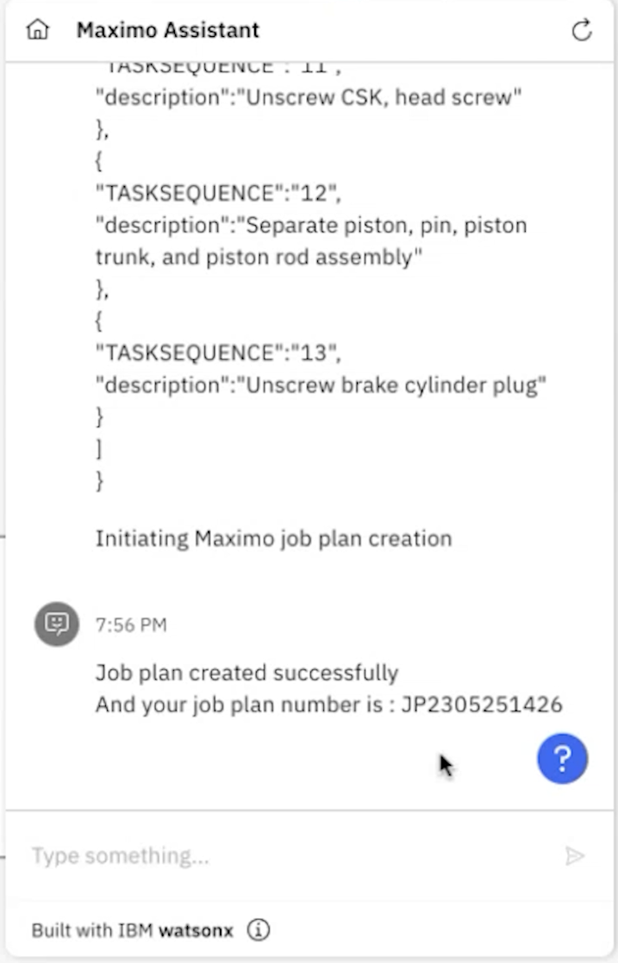
Use Case 1 : Create Job Plans from Maintenance Manuals
Persona : Supervisor / Maintenance Planner
Problem Statement:
The process of creating a Job Plan in asset-intensive industries presents a significant challenge, as it involves reviewing multiple asset manuals to extract accurate repair details. This task is often cumbersome, time-consuming, and prone to inefficiencies.
Business Value:
Increase Operational Efficiency by minimizing manual input during job plan creation, freeing up valuable time.
Enhance Maintenance Quality through consistent and accurate job plans, reducing the risk of errors and rework.
Accelerate Work Execution by enabling faster job plan generation, ensuring timely issuance of work orders.
Boost Productivity by automating repetitive tasks, allowing focus on higher-value planning and strategy activities.
Solution Overview:
Leverage AI-powered document processing to extract repair and maintenance instructions from asset manuals.
Automatically structure the extracted information into Maximo-compatible Job Plans with detailed tasks.
Integrate with Maximo through APIs and Microservices for seamless Job Plan creation.
Present the generated task details on-screen for quick review, allowing the planner to validate and refine the job plan.

Slide 13
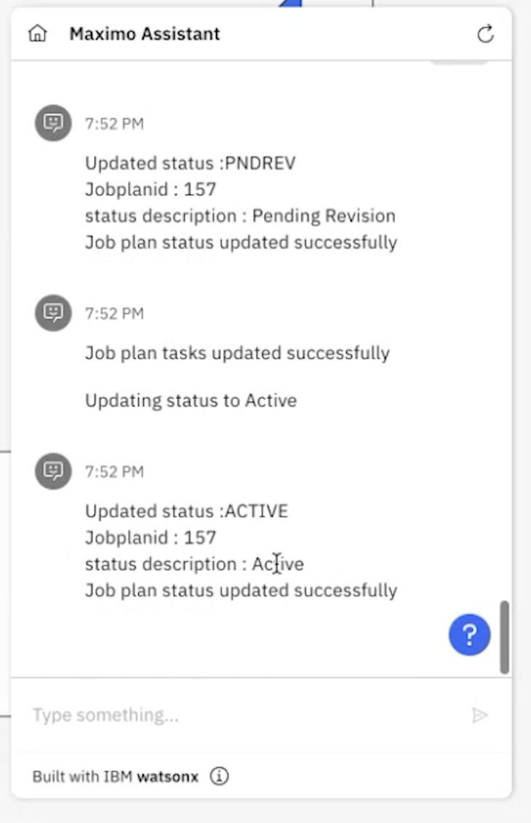
Use Case 2 : Job Plan Task Optimization using AI
Persona : Supervisor / Maintenance Planner
Problem Statement:
Inaccurate or poorly sequenced job plan tasks during asset maintenance can lead to extended downtime, resulting in decreased productivity and increased costs.
Business Value:
Improve Maintenance Effectiveness by delivering clear, actionable job plans with simplified, well-structured tasks.
Reduce Downtime through accurately sequenced tasks that prevent delays during maintenance execution.
Enhance Technician Performance by eliminating ambiguity, leading to smoother and more reliable task completion.
Increase Planning Efficiency and Confidence by equipping planners with tools to produce high-quality, execution-ready job plans.
Solution Overview:
Use AI/NLP models to analyze existing job plans and identify opportunities to split large or vague tasks into smaller, meaningful steps.
Automatically suggest improved task sequences based on best practices.
Display the restructured task list on-screen for planner review, allowing validation and edits before applying changes.
Update the job plan in Maximo by following the standard Job Plan revision process, ensuring version control and compliance with Maximo’s change management practices.
Ensure that improved job plans are available for future work orders with enhanced clarity and structure.

Slide 14
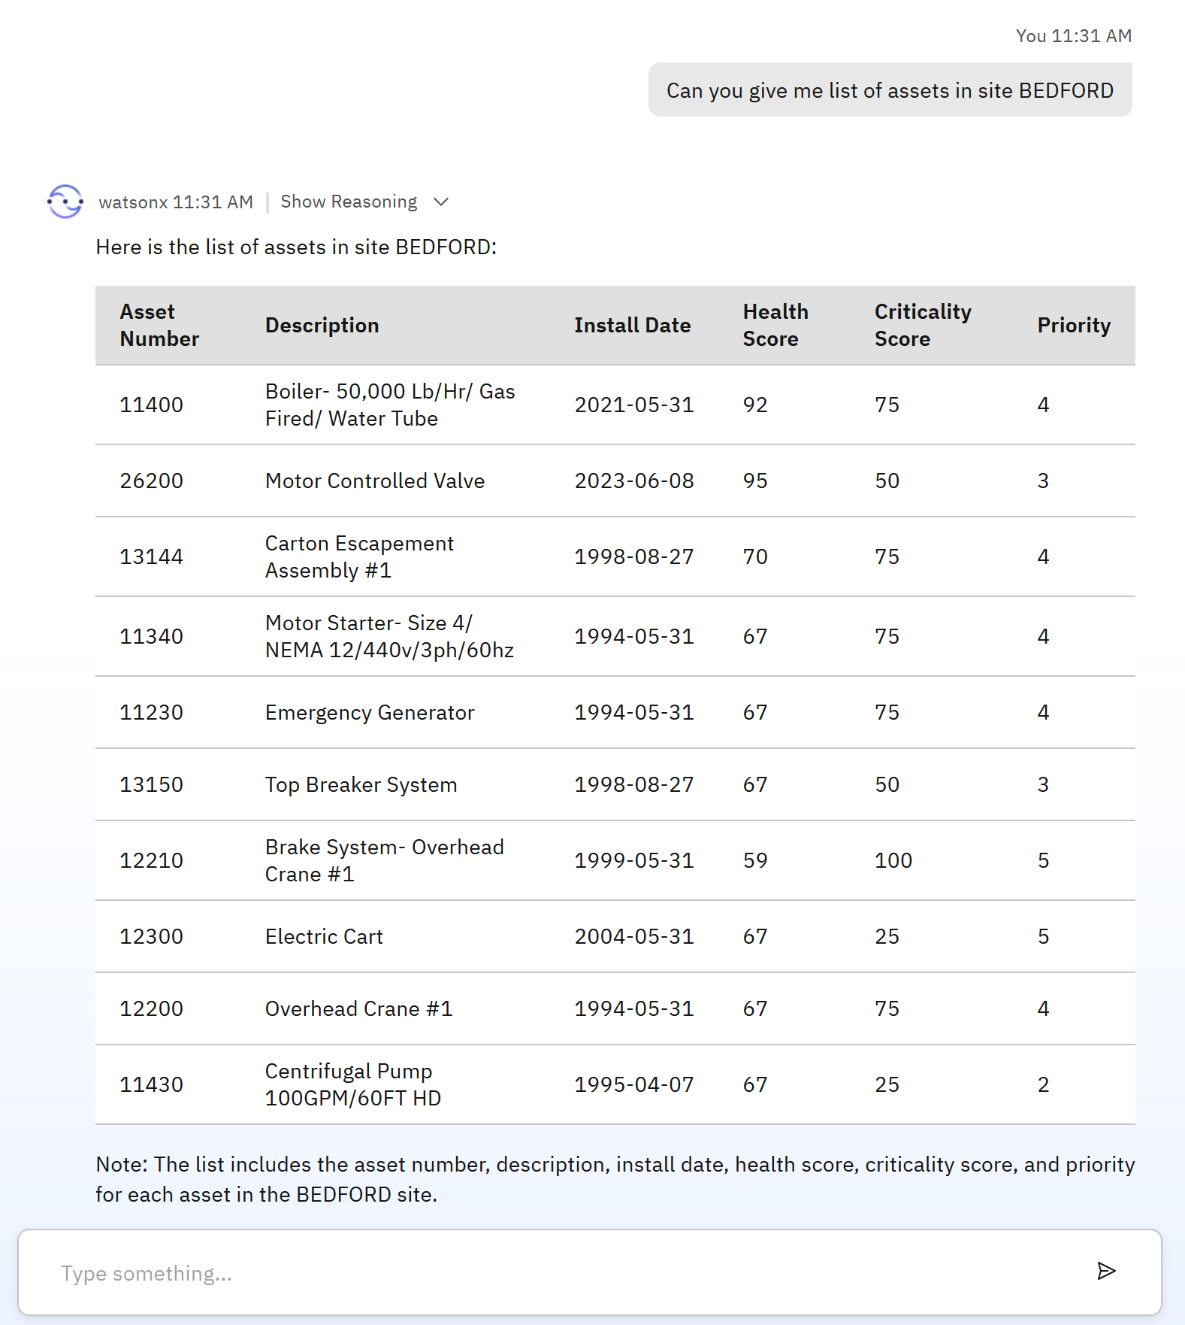
Use Case 3 : Maximo AI Agent
Persona : Reliability Engineer
Problem Statement:
Reliability Engineers often struggle to quickly access essential information about critical assets during site visits, resulting in delays, reduced decision-making efficiency, and potential impacts on maintenance outcomes.
Business Value:
Empower Field Reliability Engineers with instant access to accurate asset information, improving on-site efficiency.
Boost Productivity by minimizing time spent searching for asset details.
Accelerate Maintenance Decisions through rapid access to relevant data, enabling quicker responses during site visits.
Enhance User Engagement with intuitive, AI-driven conversational interfaces seamlessly integrated into Maximo.
Solution Overview:
Deploy AI-powered agents integrated with Maximo to provide instant answers to asset-related queries via chat.

Slide 15
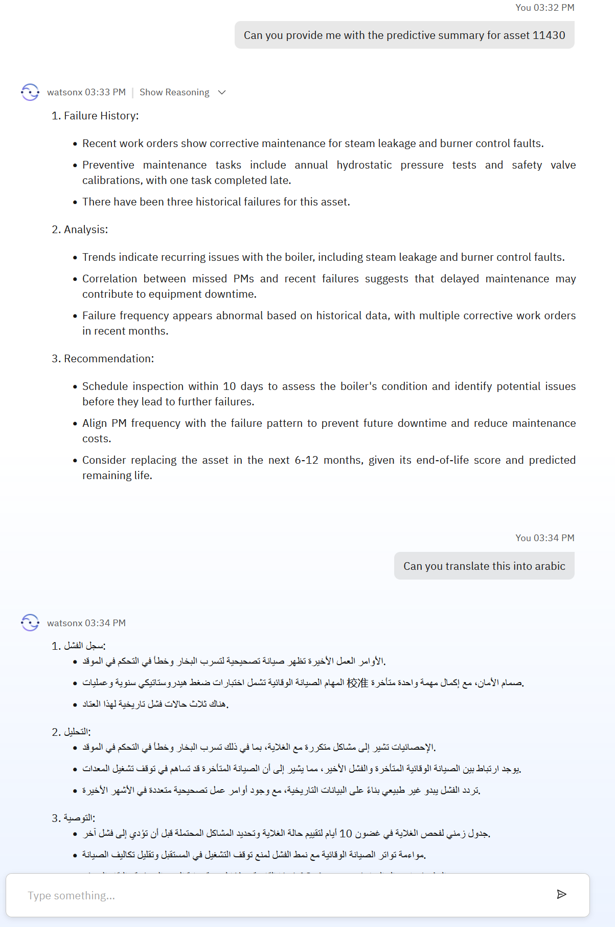
Use Case 4 : Multi-AI agents in Maximo
Persona : Reliability Engineer
Problem Statement:
As a Reliability Engineer, generate health assessments for all critical assets in the facility by consolidating asset health data, KPIs, failure history, preventive maintenance, and work order data within Maximo, enabling proactive maintenance decisions through predictive insights that help prevent unplanned downtime.
Business Value:
Improve Asset Reliability by automating comprehensive health assessments for all critical equipment.
Reduce Unplanned Downtime through predictive insights that drive proactive maintenance strategies.
Enhance Operational Decisions by equipping Reliability Engineers with faster, data-driven insights.
Support Global Operations with multi-language AI interactions that ensure accessibility and consistency across teams.
Solution Overview:
Utilize Multi-AI agents in Maximo, each specialized in extracting and analysing specific data sets.
Orchestrate these agents to collaboratively generate a unified health assessment for each critical asset.
Provide Predictive insights to support proactive maintenance planning and reduce unplanned downtime.
Incorporate Multi-language support, allowing Reliability Engineers across global sites to access, understand, and act on the insights in their preferred language.

